Slide 1
Design Principle and Design Pattern
Vijay Chouhan

Slide 2
Design Principle
Overview of Design Principle
Liskov Substitution Principle
SOLID Design Principle
Interface Segregation Principle
Single Responsibility Principle
Dependency Inversion Principle
Open /Close Principle

Slide 3
Design Principle
Software design principles represent a set of guidelines that helps us to avoid having a bad design. The design principles are associated to Robert Martin who gathered them in "Agile Software Development: Principles, Patterns, and Practices". According to Robert Martin there are 3 important characteristics of a bad design that should be avoided:
Rigidity - It is hard to change because every change affects too many other parts of the system.
Fragility - When you make a change, unexpected parts of the system break.
Immobility - It is hard to reuse in another application because it cannot be separated from the current application.

Slide 4
SOLID Design Principle
SOLID principles are a subset of many principles promoted by Robert C. Martin, and those are given below,
S - Single Responsibility Principle
O - Open /Close Principle
L - Liskov Substitution Principle
I - Interface Segregation Principle
D - Dependency Inversion Principle

Slide 5
Single Responsibility Principle
“A class should have only one reason to change.” - Robert C. Martin
In this context a responsibility is considered to be one reason to change.
This principle states that if we have 2 reasons to change for a class, we have to split the functionality in two classes. Each class will handle only one responsibility and on future if we need to make one change we are going to make it in the class which handle it. When we need to make a change in a class having more responsibilities the change might affect the other functionality of the classes.

Slide 6
Open /Close Principle
“Software entities (classes, modules, functions, etc.) should be open for extension, but closed for modification“ - Bertrand Meyer in 1988
This means entity can allow its behavior to be extended without modifying its source code.
A module will be said to be open if it is still available for extension. For example, it should be possible to add fields to the data structures it contains, or new elements to the set of functions it performs.
A module will be said to be closed if it is available for use by other modules. This assumes that the module has been given a well-defined, stable description.

Slide 7
Liskov Substitution Principle
This principle was initially introduced by Barbara Liskov in a 1987.
“If S is a subtype of T, then objects of type T in a program may be replaced with objects of type S without altering any of the desirable properties of that program”.
This principle is just an extension of the Open Close Principle in terms of behavior meaning that we must make sure that new derived classes are extending the base classes without changing their behavior. The new derived classes should be able to replace the base classes without any change in the code.

Slide 8
Interface Segregation Principle
The interface-segregation principle (ISP) states that - “No client should be forced to depend on methods it does not use”. – Robert C. Martin
ISP splits interfaces that are very large into smaller and more specific ones so that clients will only have to know about the methods that are of interest to them. Such shrunken interfaces are also called role interfaces.
ISP is intended to keep a system decoupled and thus easier to refractor, change, and redeploy.
Example - When we write our interfaces we should take care to add only methods that should be there. If we add methods that should not be there, then the classes implementing the interface will have to implement those methods as well.

Slide 9
Dependency Inversion Principle
Principles states –
High-level modules should not depend on low-level modules. Both should depend on abstractions.
Abstractions should not depend on details. Details should depend on abstractions.
Dependency Inversion Principle states that we should decouple high level modules from low level modules, by introducing an abstraction layer between the high level classes and low level classes. Further more it inverts the dependency: instead of writing our abstractions based on details, the we should write the details based on abstractions.

Slide 10
Design Patterns
Overview of Design Pattern
Types of Design Pattern
Creational Patterns,
Structural Patterns,
Behavioral Patterns.
Gang of Four(GOF)
Uses of Design Pattern
Some Design Patterns
Benefits of using Design Pattern

Slide 11
Design Pattern Overview
Design patterns represent the best practices used by experienced object-oriented software developers.
Design patterns are well-proved solution for specific problems/task that software developers faced during software development.
These solutions were obtained by trial and error by numerous software developers over quite a substantial period of time.

Slide 12
Gang of Four (GOF)
Four authors Erich Gamma, Richard Helm, Ralph Johnson and John Vlissides are collectively known as Gang of Four (GOF).
They published a book titled Design Patterns - Elements of Reusable Object-Oriented Software in 1994, which initiated the concept of Design Patterns.
These design patterns based on following principle,
Program to an interface not an implementation,
Favor object composition over inheritance

Slide 13
Uses of Design Pattern
Design Patterns have two main usages in software development,
Common platform for developers :-
Design patterns provide a standard terminology and are specific to particular scenario.
For example, a singleton design pattern signifies use of single object so all developers familiar with single design pattern will follow the same path.
Best Practices :-
Design patterns have been evolved over a long period of time and they provide best solutions to certain problems faced during software development.

Slide 14
Benefits of using Design Pattern
They give the developer a selection of tried and tested solutions to work with,
They are language neutral and so can be applied to any language that supports object-orientation,
They aid communication by the very fact that they are well documented and can be researched if that is not the case,
They have a proven track record as they are already widely used and thus reduce the technical risk to the project,
They are highly flexible and can be used in practically any type of application or domain,

Slide 15
Type of Design Pattern
Creational Patterns:- These design patterns provide a way to create objects while hiding the creation logic, rather than instantiating objects directly using new operator.
Structural Patterns:- These design patterns concern class and object composition. Concept of inheritance is used to compose interfaces and define ways to compose objects to obtain new functionalities.
Behavioral Patterns:- These design patterns are specifically concerned with communication between objects.

Slide 16
Type of Design Pattern
Creational Pattern
Factory Method Pattern
Structural Pattern
Adapter Pattern
Behavioral Pattern
Chain of Responsibility
Abstract Factory Pattern
Singleton Pattern
Prototype Pattern
Builder Pattern
Object Pool Pattern
Bridge Pattern
Composite Pattern
Decorator Pattern
Facade Pattern
Flyweight Pattern
proxy Pattern
Command Pattern
Interpreter Pattern
Iterator Pattern

Slide 17
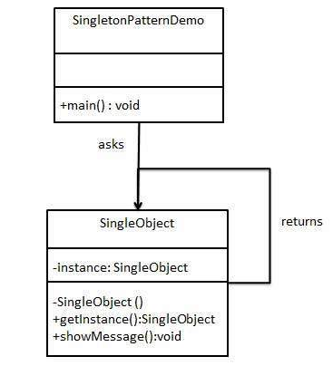
Singleton of Design Pattern
This design pattern comes under creational pattern. This pattern involves a single class which is responsible to create an object while making sure that only single object gets created.
Class Diagram :-

Slide 18
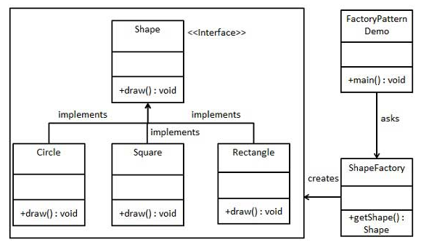
Factory Pattern
This design pattern comes under creational pattern. In Factory pattern, we create object without exposing the creation logic to the client and refer to newly created object using a common interface.
Class Diagram :-

Slide 19
Abstract Factory Pattern
This design pattern comes under creational pattern. This factory is also called as factory of factories.
In Abstract Factory pattern an interface is responsible for creating a factory of related objects without explicitly specifying their classes. Each generated factory can give the objects as per the Factory pattern.

Slide 20
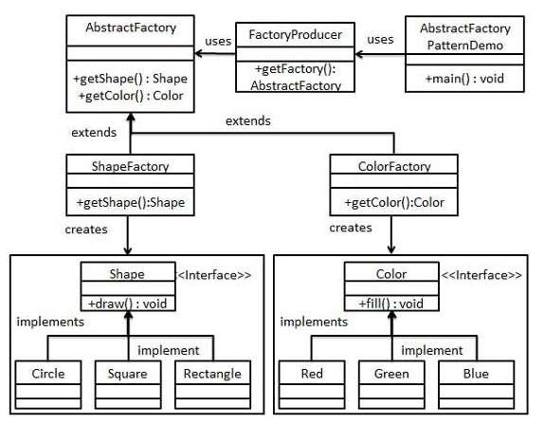
Abstract Factory Pattern
Class Diagram :-

Slide 21
Adapter Design Pattern
Adapter pattern works as a bridge between two incompatible interfaces. This type of design pattern comes under structural pattern as this pattern combines the capability of two independent interfaces. This pattern involves a single class which is responsible to join functionalities of independent or incompatible interfaces.
A real life example could be a case of card reader which acts as an adapter between memory card and a laptop. You plugin the memory card into card reader and card reader into the laptop so that memory card can be read via laptop.

Slide 22
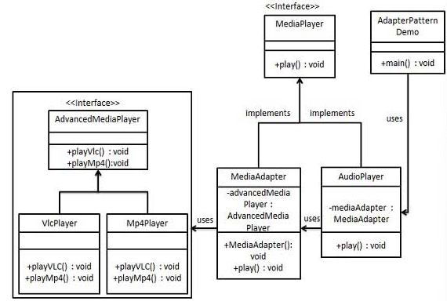
Adapter Design Pattern
Class Diagram :-
We have two interface MediaPlayer(mp3) and AdvancedMediaPlayer(vlc and mp4) and their implementing classes.
We want to make AudioPlayer to play other formats as well. To attain this, we have created an adapter class MediaAdapter which implements the MediaPlayer interface and uses AdvancedMediaPlayer objects to play the required format.
AudioPlayer uses the adapter class MediaAdapter to play the desired format.

Slide 23
Facade Design Pattern
Facade pattern hides the complexities of the system and provides an interface to the client using which the client can access the system. This type of design pattern comes under structural pattern as this pattern adds an interface to existing system to hide its complexities.
This pattern involves a single class which provides simplified methods required by client and delegates calls to methods of existing system classes.

Slide 24
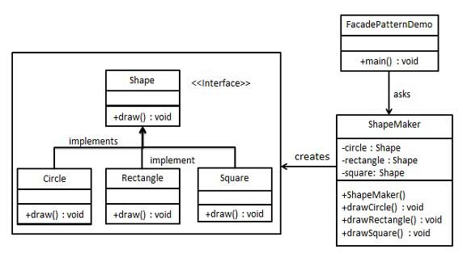
Facade Design Pattern
Class Diagram :-
Create a Shape interface and concrete classes implementing the Shape interface. ShapeMaker class uses the concrete classes to delegate user calls to these classes. FacadePatternDemo, our demo class, will use ShapeMaker class to show the results.

Slide 25
Prototype Design Pattern
Prototype pattern refers to creating duplicate object while keeping performance in mind. This type of design pattern comes under creational pattern as this pattern provides one of the best ways to create an object.
This pattern involves implementing a prototype interface which tells to create a clone of the current object. This pattern is used when creation of object directly is costly.

Slide 26
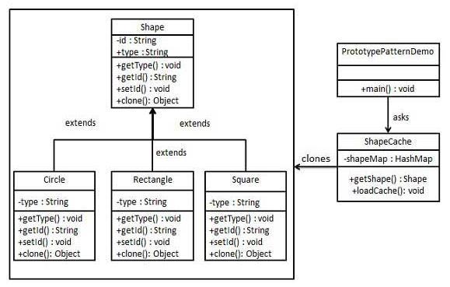
Prototype Design Pattern
Class Diagram :-
Create an abstract class Shape and concrete classes extending the Shape class. A class ShapeCache is defined as a next step which stores shape objects in a Hashtable and returns their clone when requested.

Slide 27
Thanks

